Slide 1
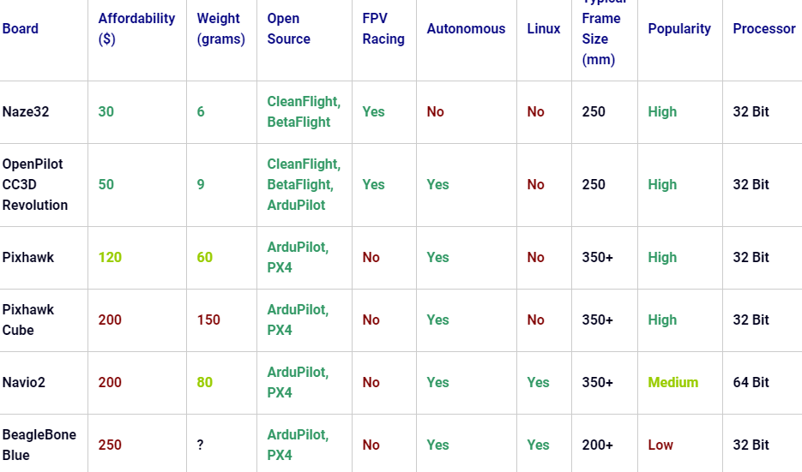
Currently there are 2 highly used opensource drone platforms. #PX4: Heavily documented, industry driven, modular architecture #Ardupilot: Easy implementation, hobbyist driven.
Both of them can be ported to popular flight controllers
Introduction

Slide 2
Height measurement depends on the hardware.
Barometer used in state of the art opensource platforms: #MS5611(Internal): 10cm resolution #BMP180(External):8.31cm resolution #BMP280(External):1.33cm resolution but with +/- 1m accuracy #GPS :Accuracy of +/-45m
So what have they done? #sensor fusion: Combining of sensory data or data derived from disparate sources such that the resulting information has less uncertainty than would be possible when these sources were used individually.
Background

Slide 3
There are no 3D path planning algorithms implemented in these opensource platforms due to the uncertainty of height measurements.
..\5thsem\Pathplanning.pdf
Background (Cont.)

Slide 4
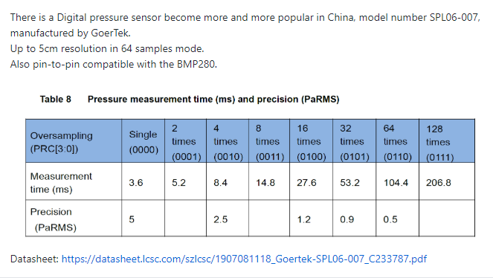
SPL06-007 barometer with a resolution of 5cm.
Solution
Sensor fusion with other altitude sensors with Karman Filter.
Implement 3D A* algorithm.

Slide 5
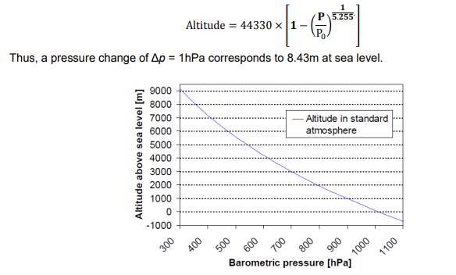
Pressure reading is not linear and changes with temperature and height.
Implementation challenges

Slide 6
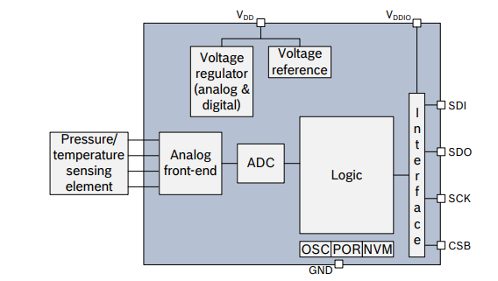
Driver draft

Slide 7
Week 1-4: # Case study, # Ordering the parts, # Familiarizing with PX4
Week 5: # 3D A*algorithm library implementation
Week 6-7: # Build a drone, implement the library and test
Week 8-10: # Finish the SPL06 driver and implement it.
Week 11-12:# Sensor fusion with GPS and BMP280
Week 13-14:# 3D A* algorithm with SPL06 barometer
Milestones

Slide 8
Driver for SPL06 barometer for PX4 platform
Sensor fused implementation with Karman filter library to get a further accurate reading.
3D path planning library with A* algorithm, implemented on a drone.
Deliverables

Slide 9
Thank you
A project by:
K.Kirishikesan 170303X

